Slide 1
Computational Semantics

Slide 2
Semantic Analysis
The purpose of semantic analysis is to draw exact meaning, or you can say dictionary meaning from the text. The work of semantic analyzer is to check the text for meaningfulness.
We already know that lexical analysis also deals with the meaning of the words, then how is semantic analysis different from lexical analysis? Lexical analysis is based on smaller token but on the other side semantic analysis focuses on larger chunks. That is why semantic analysis can be divided into the following two parts −
Studying meaning of individual word
It is the first part of the semantic analysis in which the study of the meaning of individual words is performed. This part is called lexical semantics.
Studying the combination of individual words
In the second part, the individual words will be combined to provide meaning in sentences.
The most important task of semantic analysis is to get the proper meaning of the sentence. For example, analyze the sentence “Ram is great.” In this sentence, the speaker is talking either about Lord Ram or about a person whose name is Ram. That is why the job, to get the proper meaning of the sentence, of semantic analyzer is important.

Slide 3
Elements of Semantic Analysis
Some of the critical elements of Semantic Analysis that must be scrutinized and taken into account while processing Natural Language are:
Hyponymy: Hyponymys refers to a term that is an instance of a generic term. They can be understood by taking class-object as an analogy. For example: ‘Color‘ is a hypernymy while ‘grey‘, ‘blue‘, ‘red‘, etc, are its hyponyms.
Homonymy: Homonymy refers to two or more lexical terms with the same spellings but completely distinct in meaning. For example: ‘the word “Bat” is a homonymy word because bat can be an implement to hit a ball or bat is a nocturnal flying mammal also..
Synonymy: When two or more lexical terms that might be spelt distinctly have the same or similar meaning, they are called Synonymy. For example: (Job, Occupation), (Large, Big), (Stop, Halt).
Antonymy: Antonymy refers to a pair of lexical terms that have contrasting meanings – they are symmetric to a semantic axis. For example: (Day, Night), (Hot, Cold), (Large, Small).
Polysemy: Polysemy refers to lexical terms that have the same spelling but multiple closely related meanings. It differs from homonymy because the meanings of the terms need not be closely related in the case of homonymy. For example: ‘man‘ may mean ‘the human species‘ or ‘a male human‘ or ‘an adult male human‘ – since all these different meanings bear a close association, the lexical term ‘man‘ is a polysemy.
Meronomy: Meronomy refers to a relationship wherein one lexical term is a constituent of some larger entity. For example: ‘Wheel‘ is a meronym of ‘Automobile‘

Slide 4
Meaning representation
While, as humans, it is pretty simple for us to understand the meaning of textual information, it is not so in the case of machines. Thus, machines tend to represent the text in specific formats in order to interpret its meaning. This formal structure that is used to understand the meaning of a text is called meaning representation.

Slide 5
Basic Units of Semantic System:
In order to accomplish Meaning Representation in Semantic Analysis, it is vital to understand the building units of such representations. The basic units of semantic systems are explained below:
Entity: An entity refers to a particular unit or individual in specific such as a person or a location. For example GeeksforGeeks, Delhi, etc.
Concept: A Concept may be understood as a generalization of entities. It refers to a broad class of individual units. For example Learning Portals, City, Students.
Relations: Relations help establish relationships between various entities and concepts. For example: ‘GeeksforGeeks is a Learning Portal’, ‘Delhi is a City.’, etc.
Predicate: Predicates represent the verb structures of the sentences.
In Meaning Representation, we employ these basic units to represent textual information.

Slide 6
Significance of Semantics Analysis
Semantics Analysis is a crucial part of Natural Language Processing (NLP). In the ever-expanding era of textual information, it is important for organizations to draw insights from such data to fuel businesses. Semantic Analysis helps machines interpret the meaning of texts and extract useful information, thus providing invaluable data while reducing manual efforts.
Besides, Semantics Analysis is also widely employed to facilitate the processes of automated answering systems such as chatbots – that answer user queries without any human interventions.

Slide 7
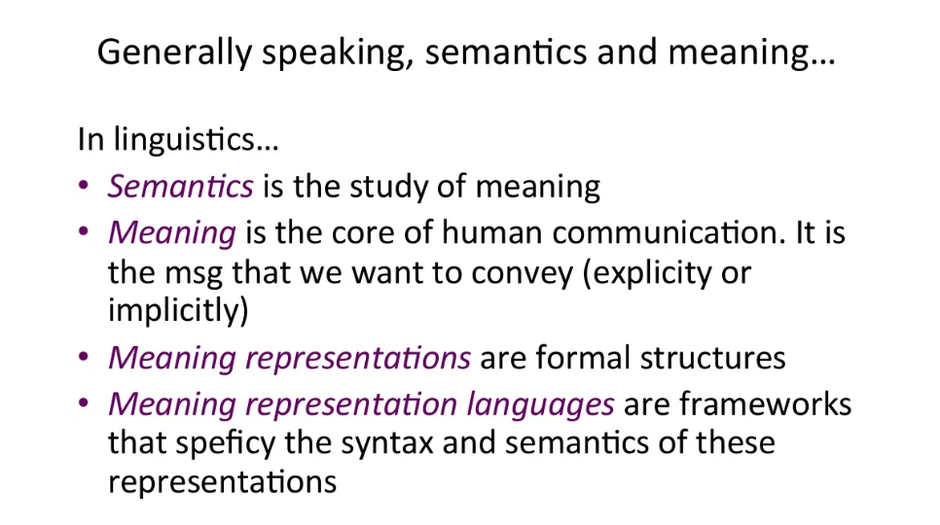

Slide 8
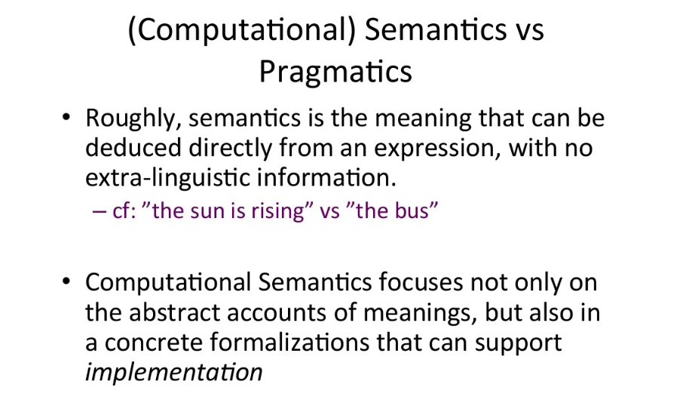

Slide 9
The study of the meaning of linguistic sentences
– Meaning of morphemes
– Meaning of words
– Meaning of phrases
• Steps for determining the meaning of a sentence
– Compute a context-independent notion of meaning in logical form (semantic interpretation)
– Interpret the logical form in context to produce the final meaning representation (contextual interpretation)
The study of language in context is called pragmatics.

Slide 10
Meaning Representation: Capturing the meaning of linguistic utterances using formal notation.
• Meaning Representation Languages: Frameworks that are used to specify the syntax and semantics of these meaning representations.
• Semantic Analysis: Mapping the linguistic utterances to these meaning representations.
• Correct meaning representation should be selected for the application.
• For certain language tasks require some form of semantic processing:
– following a recipe
– answering an essay question in exam

Slide 11
Formal representations for capturing meaning
Meaning representation (languages)
E.g., First Order Predicate Calculus (FOPC), Semantic Network, Semantic Frames, … – Algorithms for mapping from utterances to the meaning representations
• E.g., compositional semantic analysis, semantic grammars, …

Slide 12
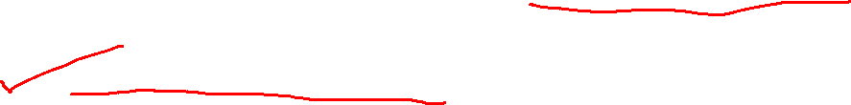
Let us look at four frequently used meaning representation languages.
– First Order Predicate Calculus
– Semantic Network
– Conceptual Dependency Diagram
– Frame-Based Representation

Slide 13

Desiderata for Meaning Representation
Verifiability – Use meaning representation to determine the relationship between the meaning of a sentence and the world we know it.
Ability to determine the truth value of the representation by looking at the information available in the knowledge base.
Example
Assume that we have the entry serve(Subway,VegetarianFood) in our KB.
– Question: Does Subway serve vegetarian food?
– The question should be converted into a logical form (a meaning representation).
– We should able to verify the truth value of the logical form of the question against our KB.

Slide 14
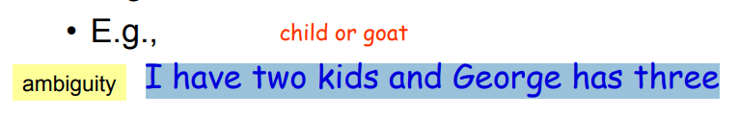

Unambiguous Representations – Single linguistic inputs may have different meaning representations assigned to them based on the circumstances in which they occur.
Example:
– Assume that we are looking the representation of “I want to eat some place near Bilkent”.
There will be different meanings of this sentence, and we will prefer one of them.
– But that chosen meaning representation CANNOT be ambiguous.

Slide 15
Unambiguous Representations
– Ambiguity
• Lexical (word sense) ambiguity
• Syntactic (structural) ambiguity
• Disambiguation
– Structural information of the sentences
– Word co-occurrence constraints

Slide 16

Vagueness: Vagueness can make it difficult to determine meaning representation, but it does not cause multiple representations.
Make it difficult to determine what to do with a particular input based on it’s meaning representations
• Some word senses are more specific than others.
Example:
I want to eat Turkish food. – Here Turkish food is vague, but it does not cause multiple representations.

Slide 17

Distinct inputs can map to the same meaning representation.
– Does Kirac have vegetarian food?
– Do they have vegetarian food at Kirac?
– Are vegetarian dishes served at Kirac?
• We shouldn’t map these sentences to different meaning representations.
• Canonical Form -- The notion that inputs that mean same thing should have the same
meaning representation.
the meaning representations for sentences with the same meaning should (ideally) both be convertible into the same canonical form, that shows their equivalence.
• To able to map distinct inputs to the same meaning representation, we should able to
know that different phrases mean the same thing such as vegetarian food and
vegetarian dishes.

Slide 18

Canonical Form
– Assign the same meaning representation to various propositions for a query
• Simplify the matching/reasoning tasks
• But complicate the semantic analysis because of different words and syntax used in the propositions
– vegetarian fare/dishes/food
– having/serving
– We can exploit the underlying systematic meaning relationships among word senses and among grammatical constructions to make this task tractable
• E.g., choosing the shared sense among words

Slide 19
Inference and Variables
– Simple matching of knowledge base will not always give the appropriate answer to the request
• E.g.: “Can vegetarians eat at Maharani?”
– The system should has the ability to draw valid conclusions based on the meaning representation of inputs and the stored background knowledge
• Determine the TRUE or FALSE of the input propositions
– Such a process is called inference

Slide 20
Inference and Variables
– For the request without making reference to any particular object, involving the use of variable is needed,
e.g.,
I’d like to find a restaurant where I can get vegetarian food.
Restaurant(x) ^ Serves(x, VegetarianFood)
– Matching is successful only if the variable can be replaced by some known object in the KB such that the entire proposition is satisfied

Slide 21
Inference -- Ability to draw valid conclusions based on the meaning representations of inputs and the background knowledge.
• We should be able to find the truth value of propositions that are not explicitly in KB -
- inference.
• Example:
– I would like to find a restaurant that serves vegetarian food.
– This example is complex and we should use variables in its representation.
– serves(x,VegetarianFood) -- a part of our meaning representation
– If there is a restaurant serves vegetarian food, our inference mechanism should be able to find it by binding the variable x to that restaurant.

Slide 22
Expressiveness
– The meaning representation scheme must be expressive enough to handle an extremely wide range of subject matter
– That’s a ideal situation!
Although this ideal situation may not be possible, but the first order predicate calculus (FOPC) is expressive enough to handle a lot of things.
• In fact, it is claimed that anything can be representable with other three representation
language, it can be also representable with FOPC.
• We will concentrate on FOPC, but other representation languages are also used.
– For example, Text Meaning Representation (TMR) used in the machine translation system.

Slide 23
Predicate-Argument Structure
All languages have a form of predicate argument arrangement at the core of their semantic structure
• Predicate
– Constants that describe events, actions, relationships and properties
• Argument
– An appropriate number of terms serve as the arguments.

Slide 24

As we have seen before
– In natural languages, some words and constituents function as predicates and some as arguments
• Example
I want Italian food.
want(I, ItalianFood)
• “want” conveys a two-argument predicate
• There are two arguments to this predicate
• Both arguments must be NPs
• The first argument (“I”) is pre-verbal and plays the role of the subject
• The second argument (“Italian food”) is postverbal and plays the role of direct object

Slide 25

Syntactic Structures:
– I want Turkish food. NP want NP
– I want to spend less than five dollars. NP want InfVP
– I want it to be close by here. NP want NP InfVP
• Verb sub-categorization rules allow the linking of the arguments of syntactic structures with the semantic roles of these arguments in the semantic representation of that sentence.
– The study of semantic roles associated with verbs is known as thematic role.
• In syntactic structures, there are restrictions on the categories of their arguments.
• Similarly, there are also semantic restrictions on the arguments of the predicates.
• The selectional restrictions specify semantic restrictions on the arguments of verbs.

Slide 26

Other objects (other than verbs) in natural languages may have predicate-argument structure.
A Turkish restaurant under fifteen dollars.
Under(TurkishRestaurant,$15)
• meaning representation is associated with the preposition under.
• The preposition under can be characterized by a two-argument predicate.
Make a reservation for this evening for a table for two persons at 8.
Reservation(Hearer,Today,8PM,2)
• meaning representation is associated with the noun reservation (not with make).
• Our meaning representation should support :
– variable predicate-argument structures
– the semantic labeling of arguments to predicates
– semantic constraints on the fillers of argument roles.

Slide 27
First Order Predicate Calculus (FOPC)
First Order Predicate Calculus (FOPC) is a flexible, well-understood, and computationally tractable approach.
• So, FOPC satisfies the most of the things that we expect from a meaning representation language.
• FOPC provides a sound computational basis for verifiability, inference, and expressiveness requirements.
• The most attractive feature of FOPC is that it makes very few specific commitments for how things should be represented.

Slide 28
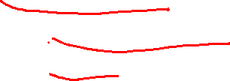
FOPC allows
– The analysis of Truth conditions
• Allows us to answer yes/no questions
– Supports the use of variables
• Allows us to answer questions through the use of variable binding
– Supports inference
• Allows us to answer questions that go beyond what we know explicitly
– Determine the truth of propositions that do not literally (exactly) present in the KB

Slide 29

Elements of FOPC
Terms: the device for representing objects
– Variables
• Make assertions and draw references about objects without having to make reference to any particular named object (anonymous objects)
• Depicted as single lower-case letters
– Constants
• Refer to specific objects in the world being described
• Depicted as single capitalized letters or single capitalized words

Slide 30

Terms: (cont.)
– Functions
• Refer to unique objects without having to associate a name constant with them
• Syntactically the same as single predicates
• Predicates:
– Symbols refer to the relations holding among some fixed number of objects in a given domain
– Or symbols refer to the properties of a single object
• Encode the category membership
– The arguments to a predicates must be terms, not other predicates

Slide 31
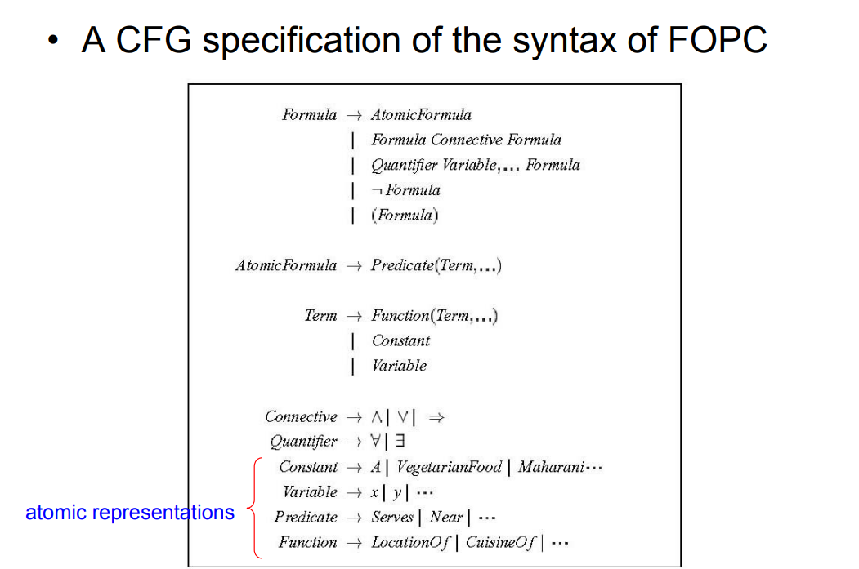


Slide 32
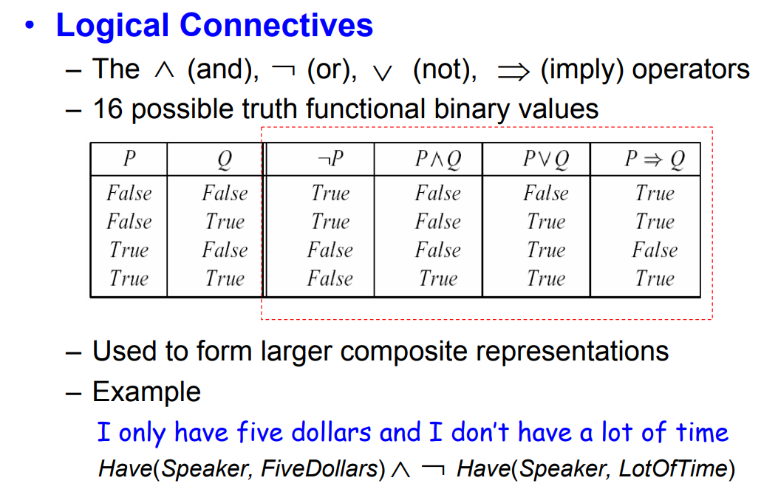


Slide 33
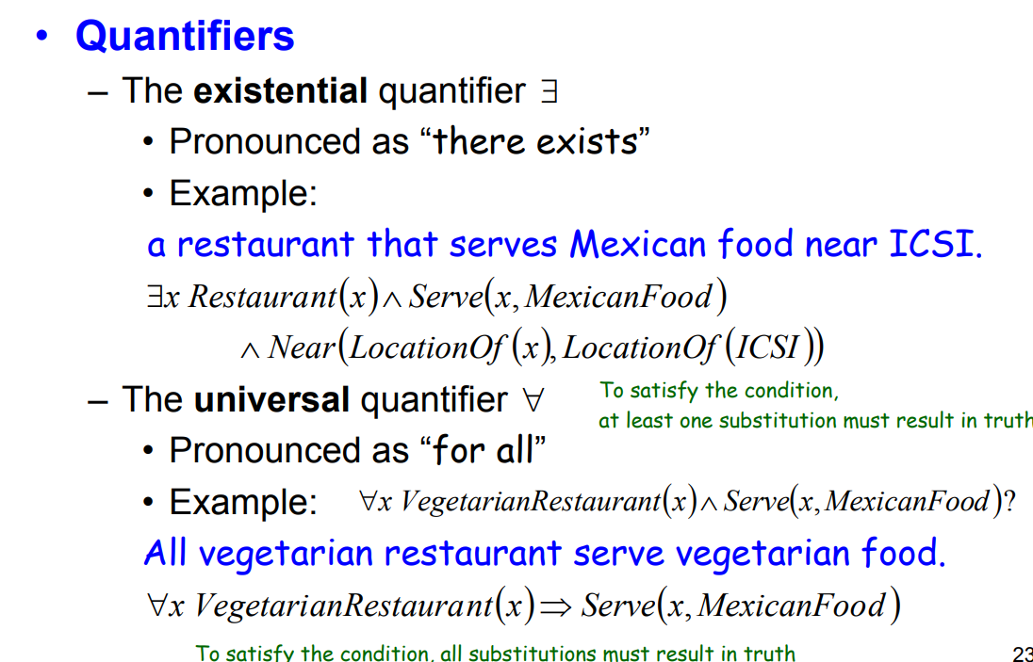

Slide 34
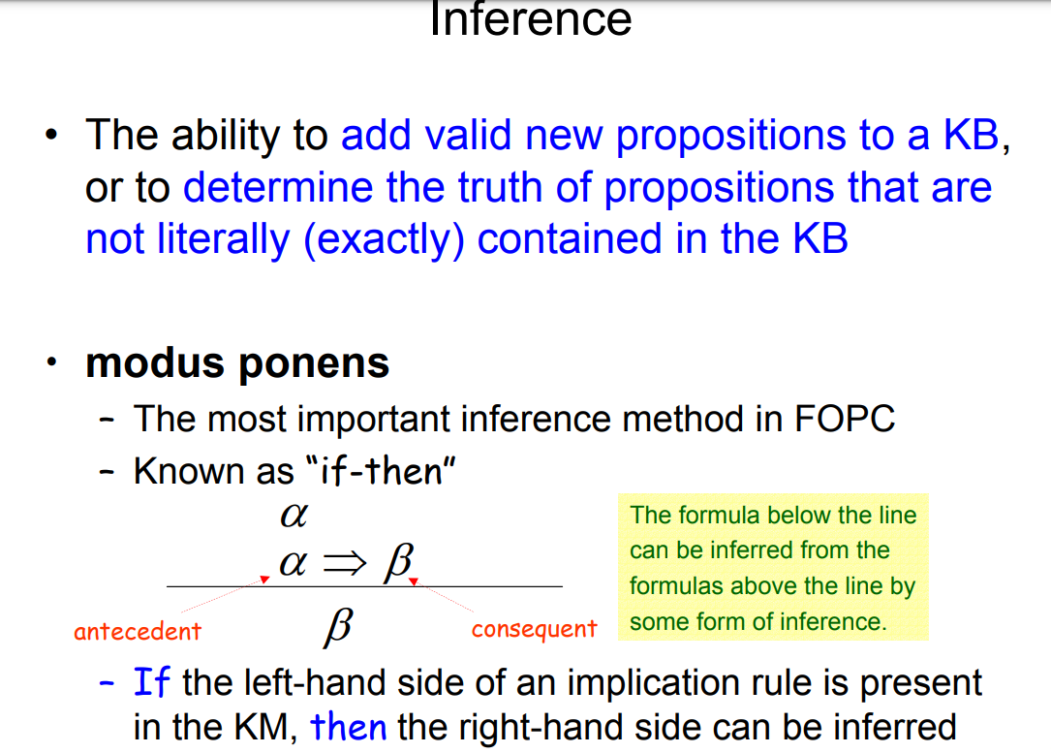

Slide 35
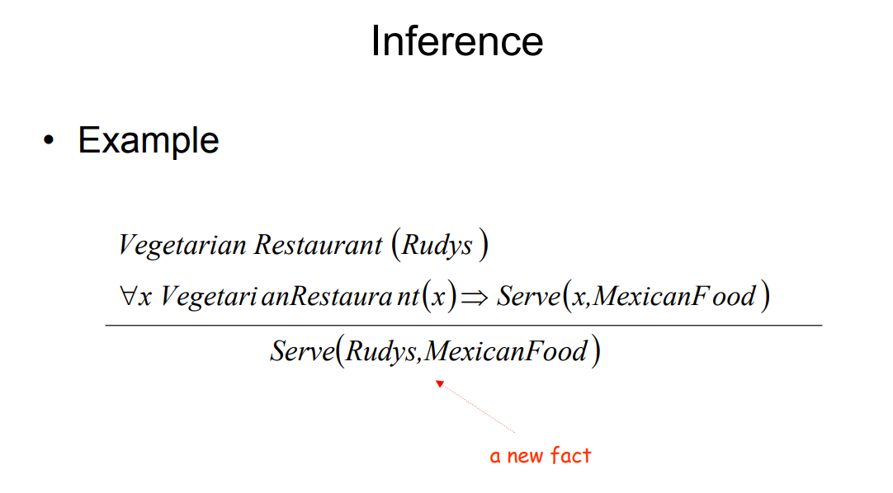

Slide 36
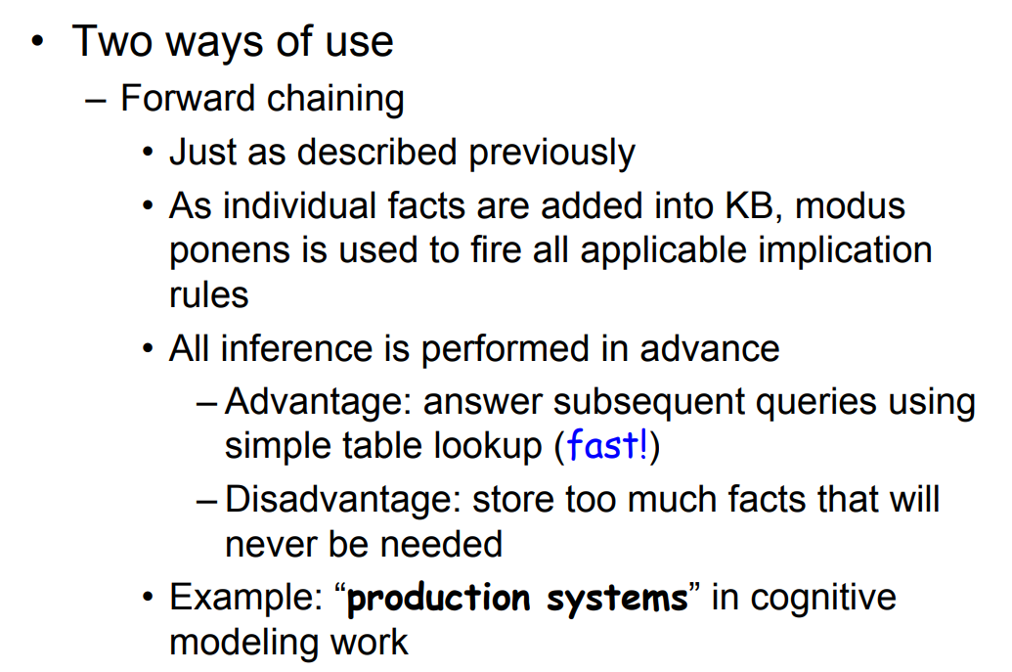

Slide 37
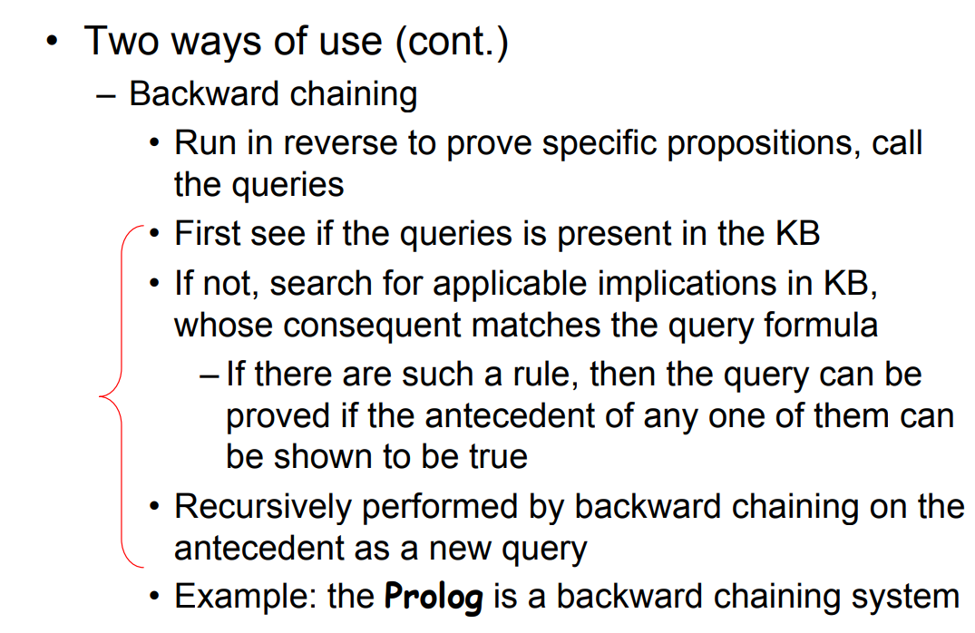

Slide 38
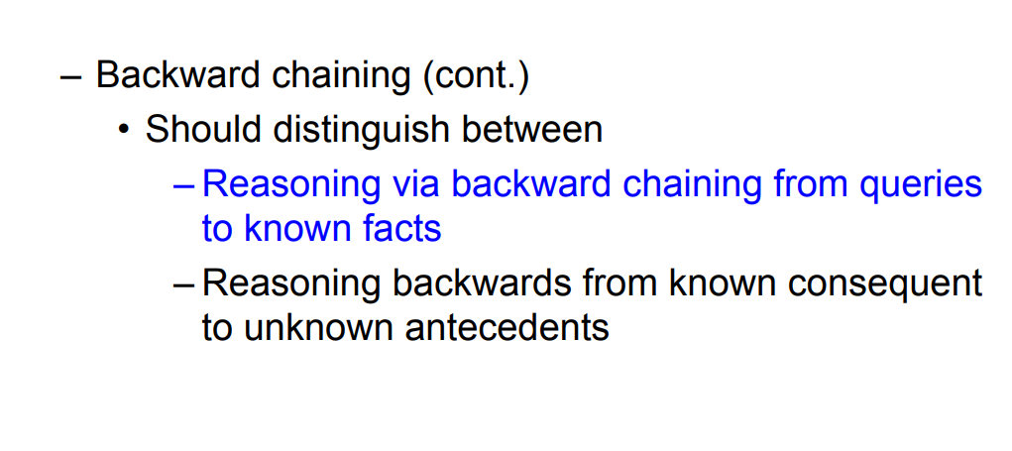

Slide 39
Several issues should be considered in meaning representation of a few important topics
– Categories
– Events
– Time
– Aspect
– Beliefs

Slide 40
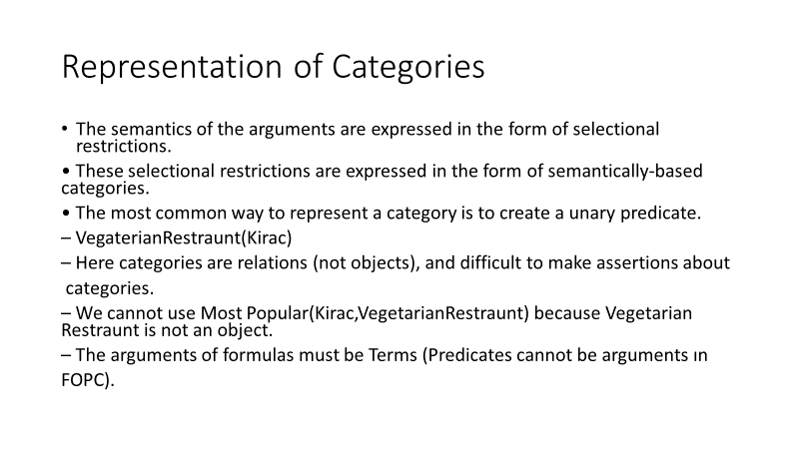

Slide 41
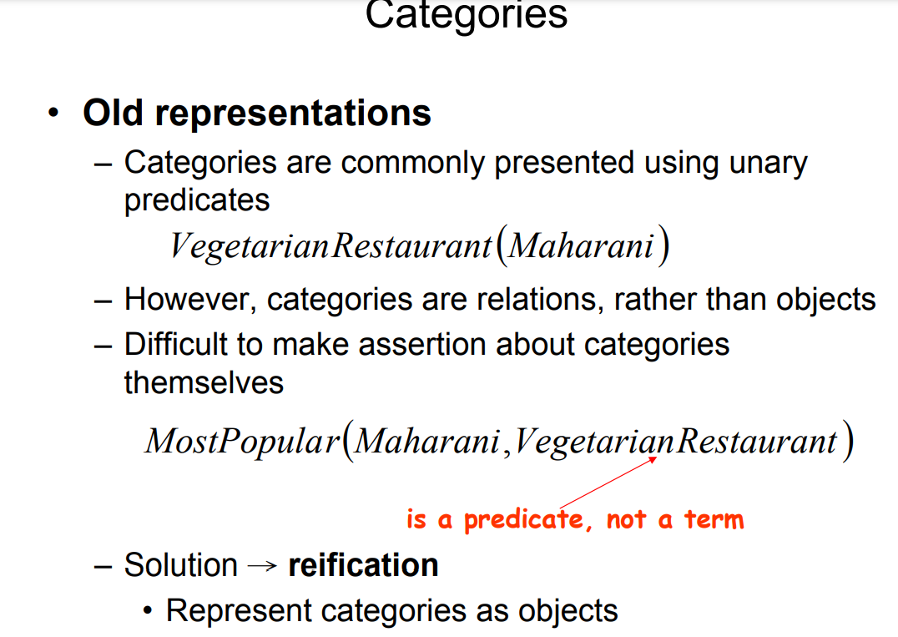

Slide 42
Solution is to make each category an object.
– This technique is know as reification.
• Thus we can define relations between objects and categories and relations between categories.
• Membership relation ISA between objects and categories.
ISA(Kirac,VegetarianRestraunt)

Slide 43
Events
Much of the semantics that we wish to capture consists of representations of states and events. States are conditions, or properties, that remain unchanged over an extended period of time, and events denote changes in some state of affairs. The representation of both states and events may involve a host of participants, props, times and locations

Slide 44
Representations of Events
The simplest approach to predicate-argument representation of a verb is to have the same number of
arguments present in that verb’s subcategorization frame.
• But this simple approach may cause some difficulties:
– determining correct number of arguments.
– Ensuring soundness and completeness
• Example:
I ate. Eating1(Speaker)
I ate a turkey sandwich Eating2(Speaker,TurkeySandwich)
I ate a turkey sandwich at my desk. Eating3(Speaker,TurkeySandwich,Desk)
I ate at my desk. Eating4(Speaker,Desk)
I ate lunch. Eating5(Speaker,Lunch)
I ate a turkey sandwich for lunch. Eating6(Speaker,TurkeySandwich,Lunch)
I ate a turkey sandwich for lunch at my desk. Eating7(Speaker,TurkeySandwich,Lunch,Desk)

Slide 45
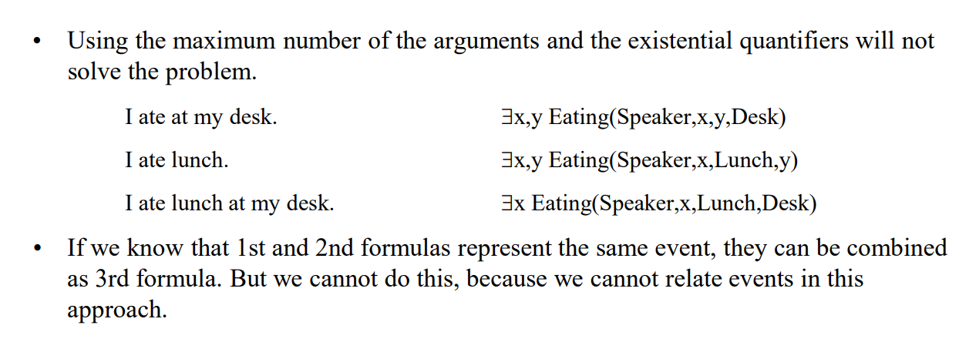
Representations of Events -- Another Approach

Slide 46
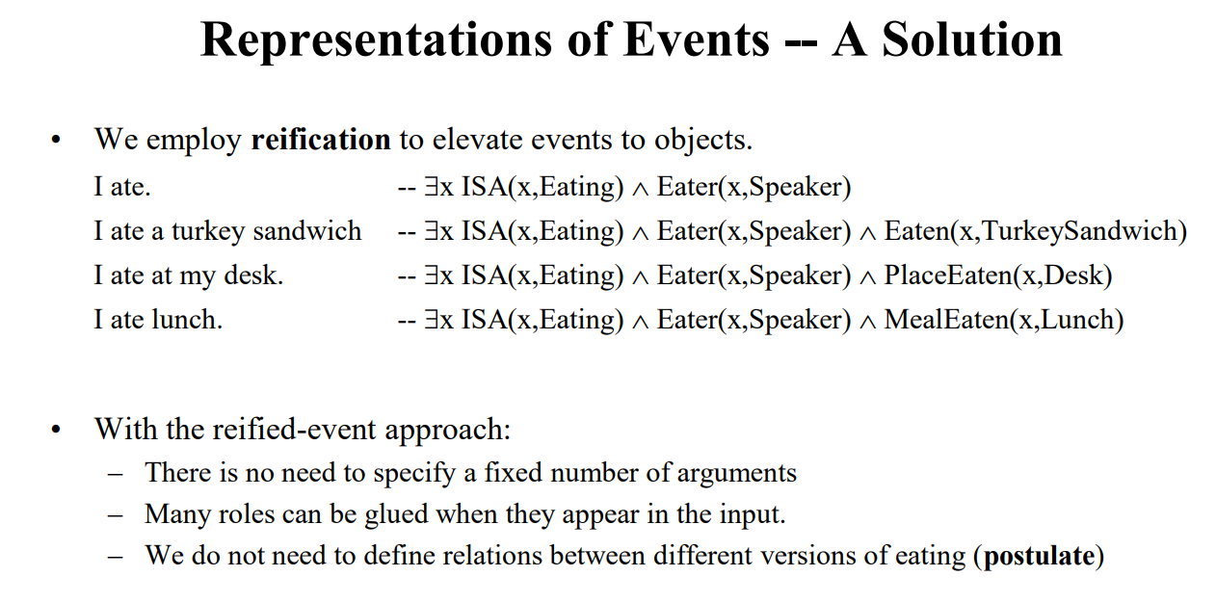
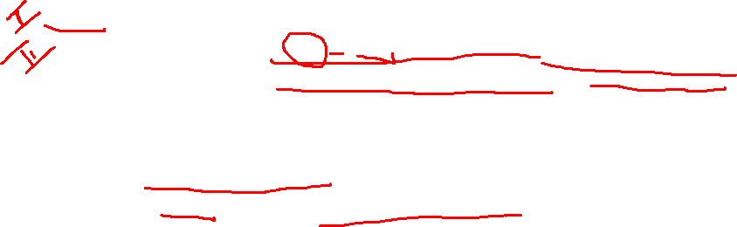

Slide 47
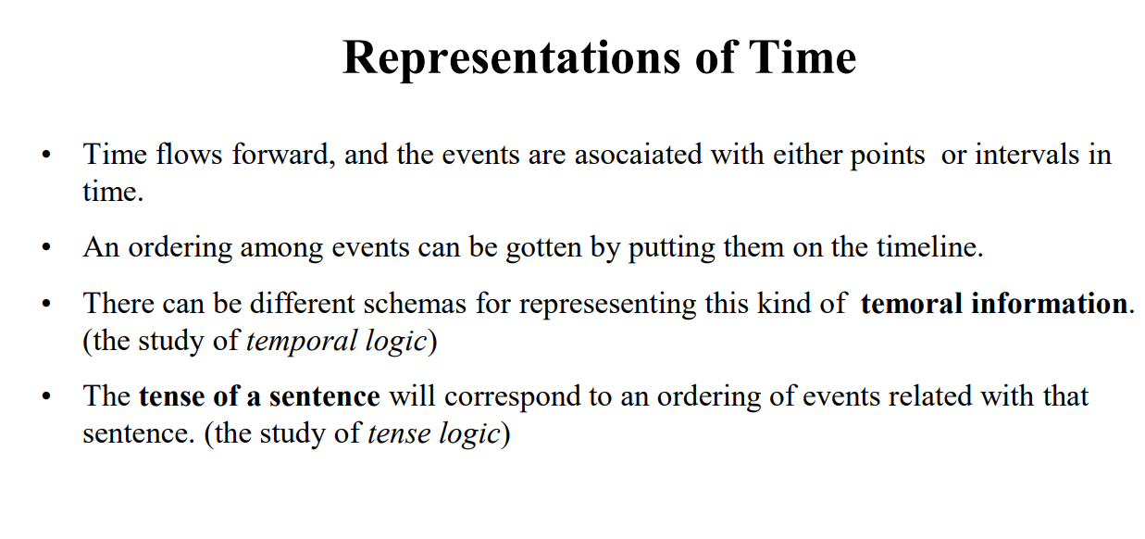

Slide 48
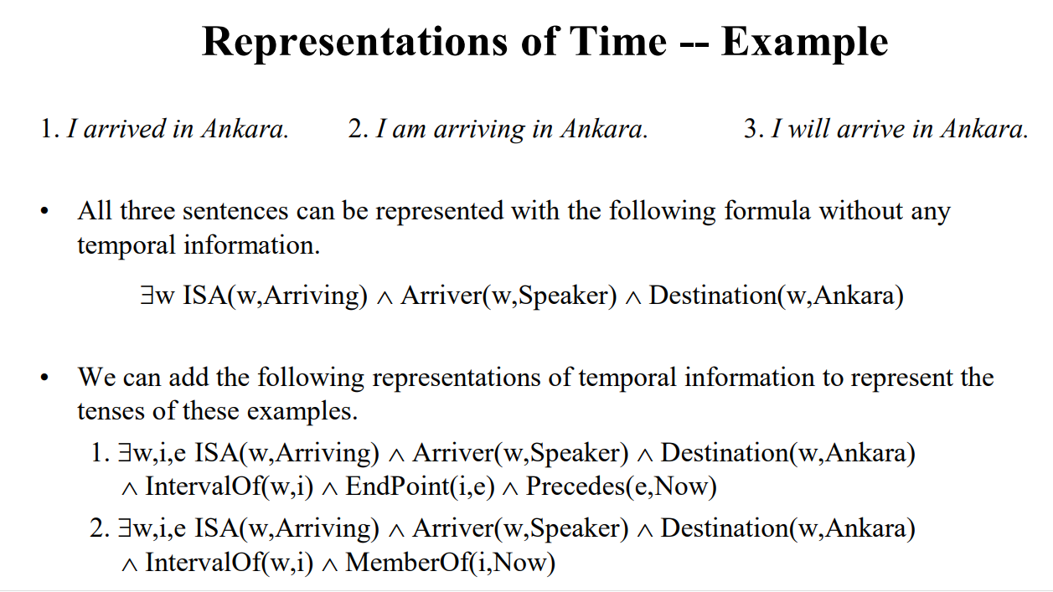

Slide 49
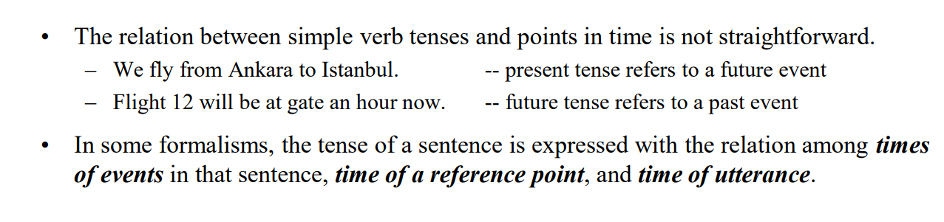

Slide 50
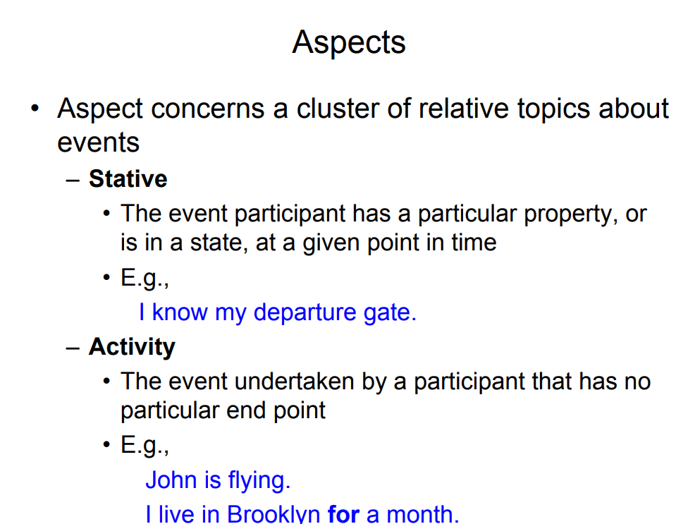

Slide 51
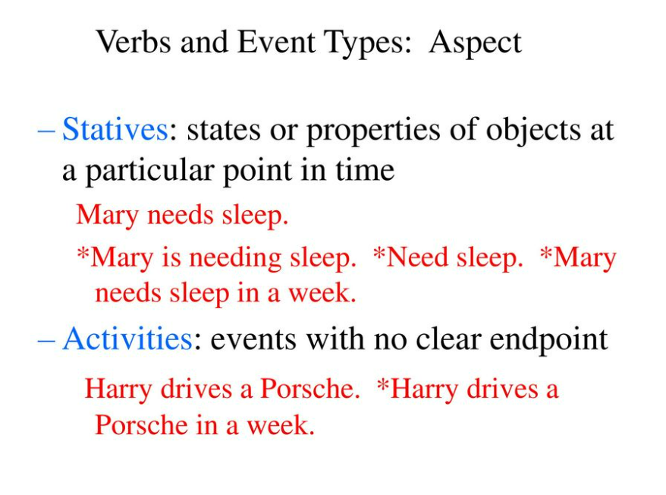

Slide 52
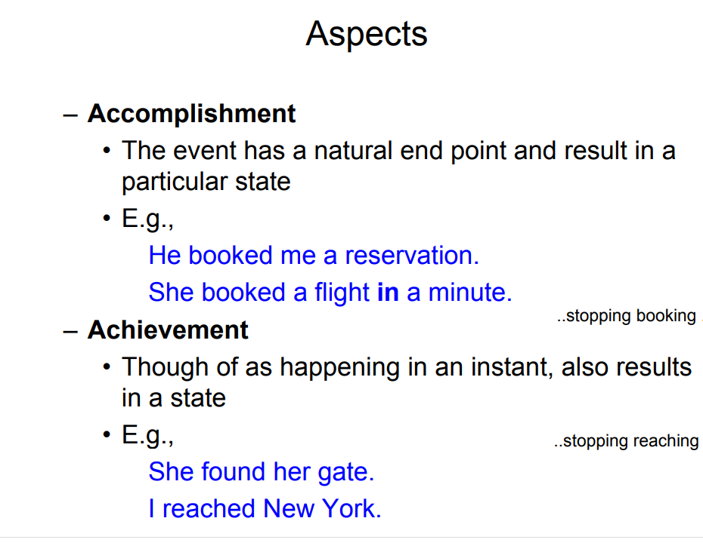

Slide 53
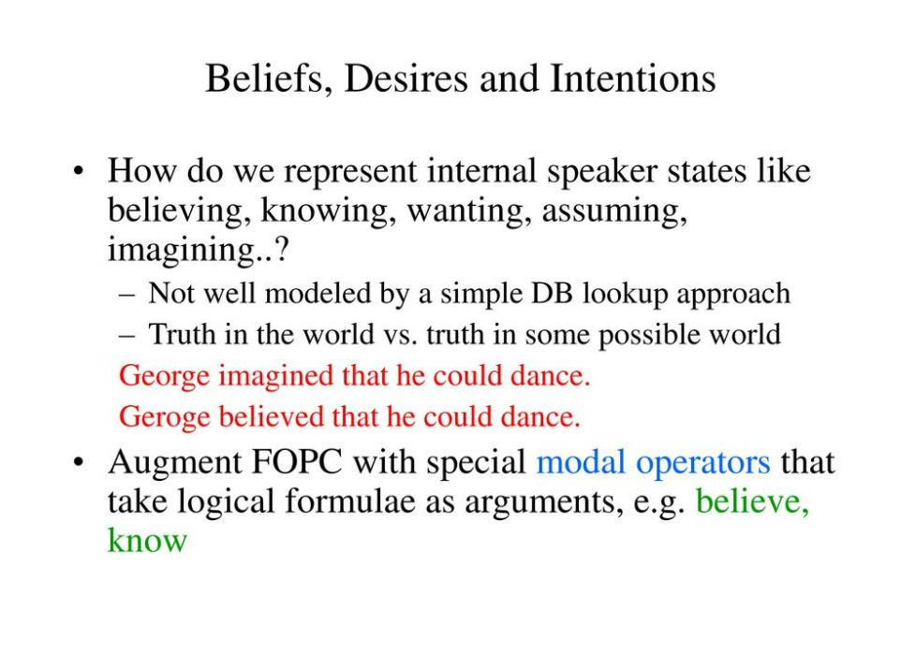

Slide 54
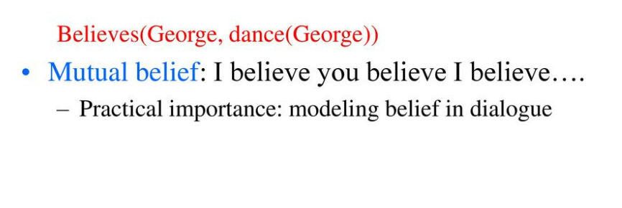

Slide 55
